Slide 1

Plots and Figures in Python
GEOL 503 Week 12, 2025

Slide 2
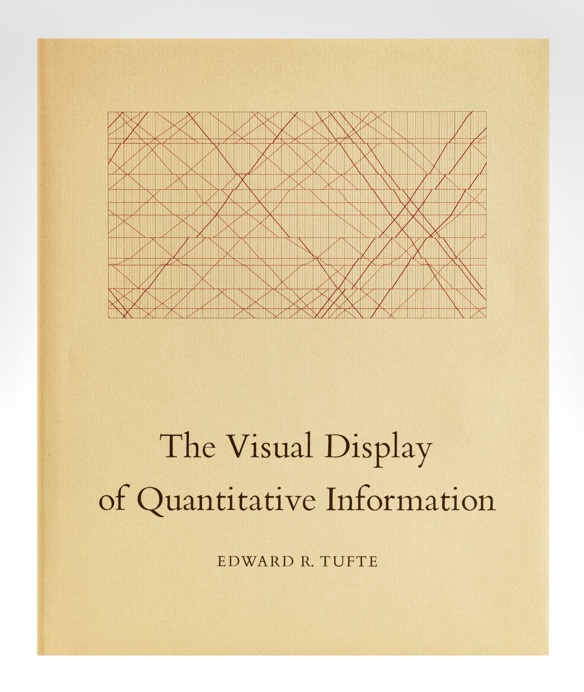
A classic in data visualization

Slide 3
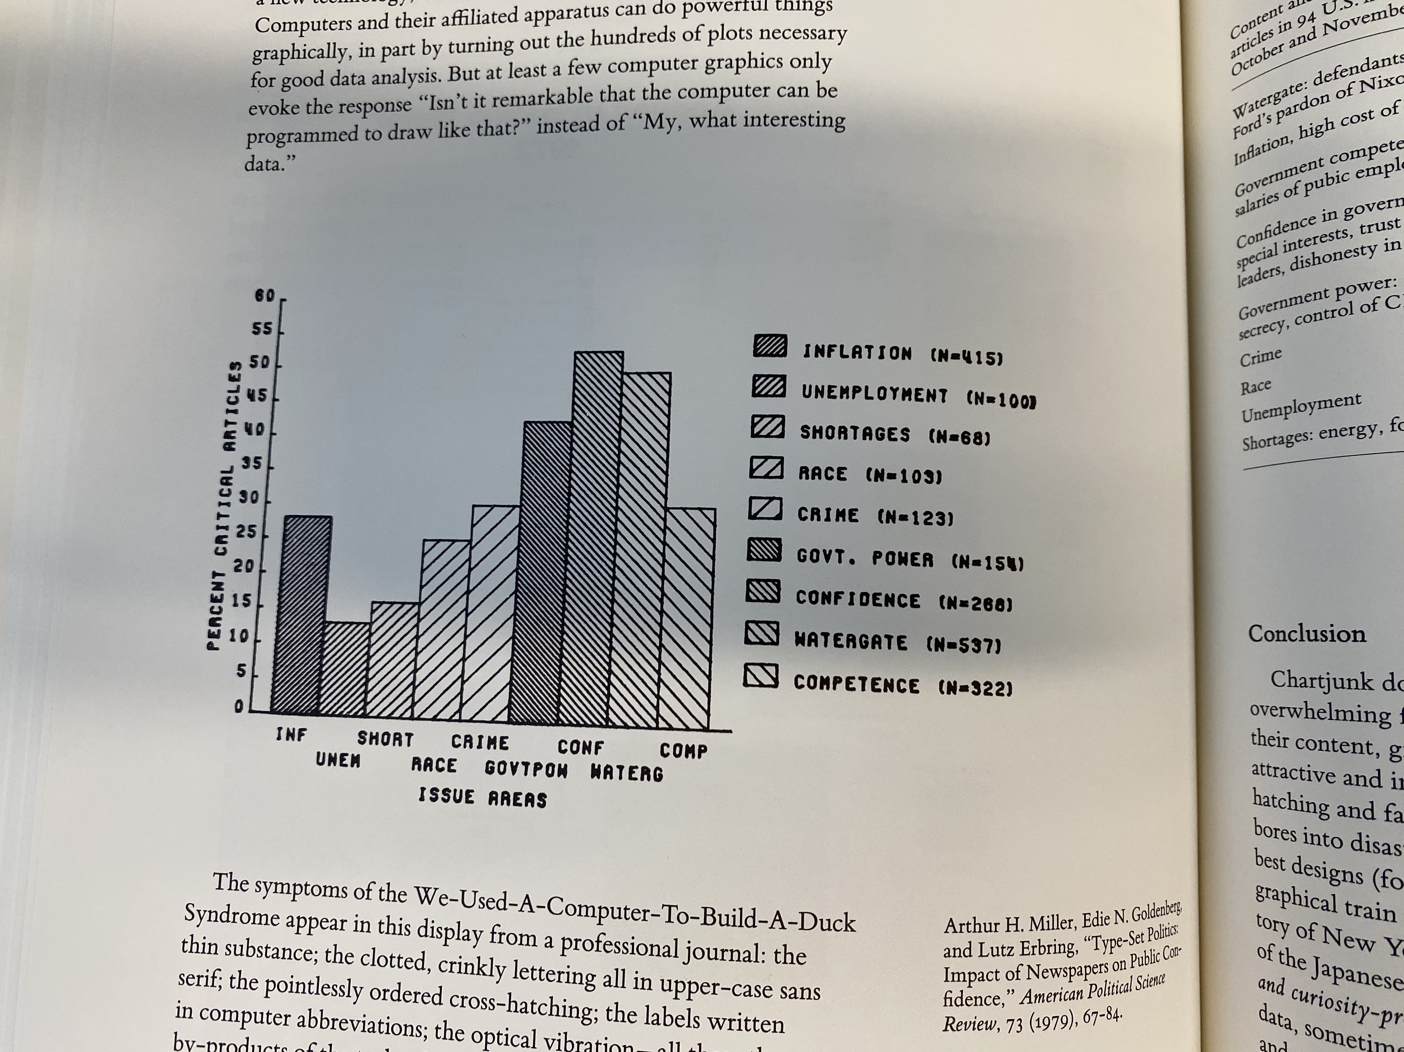
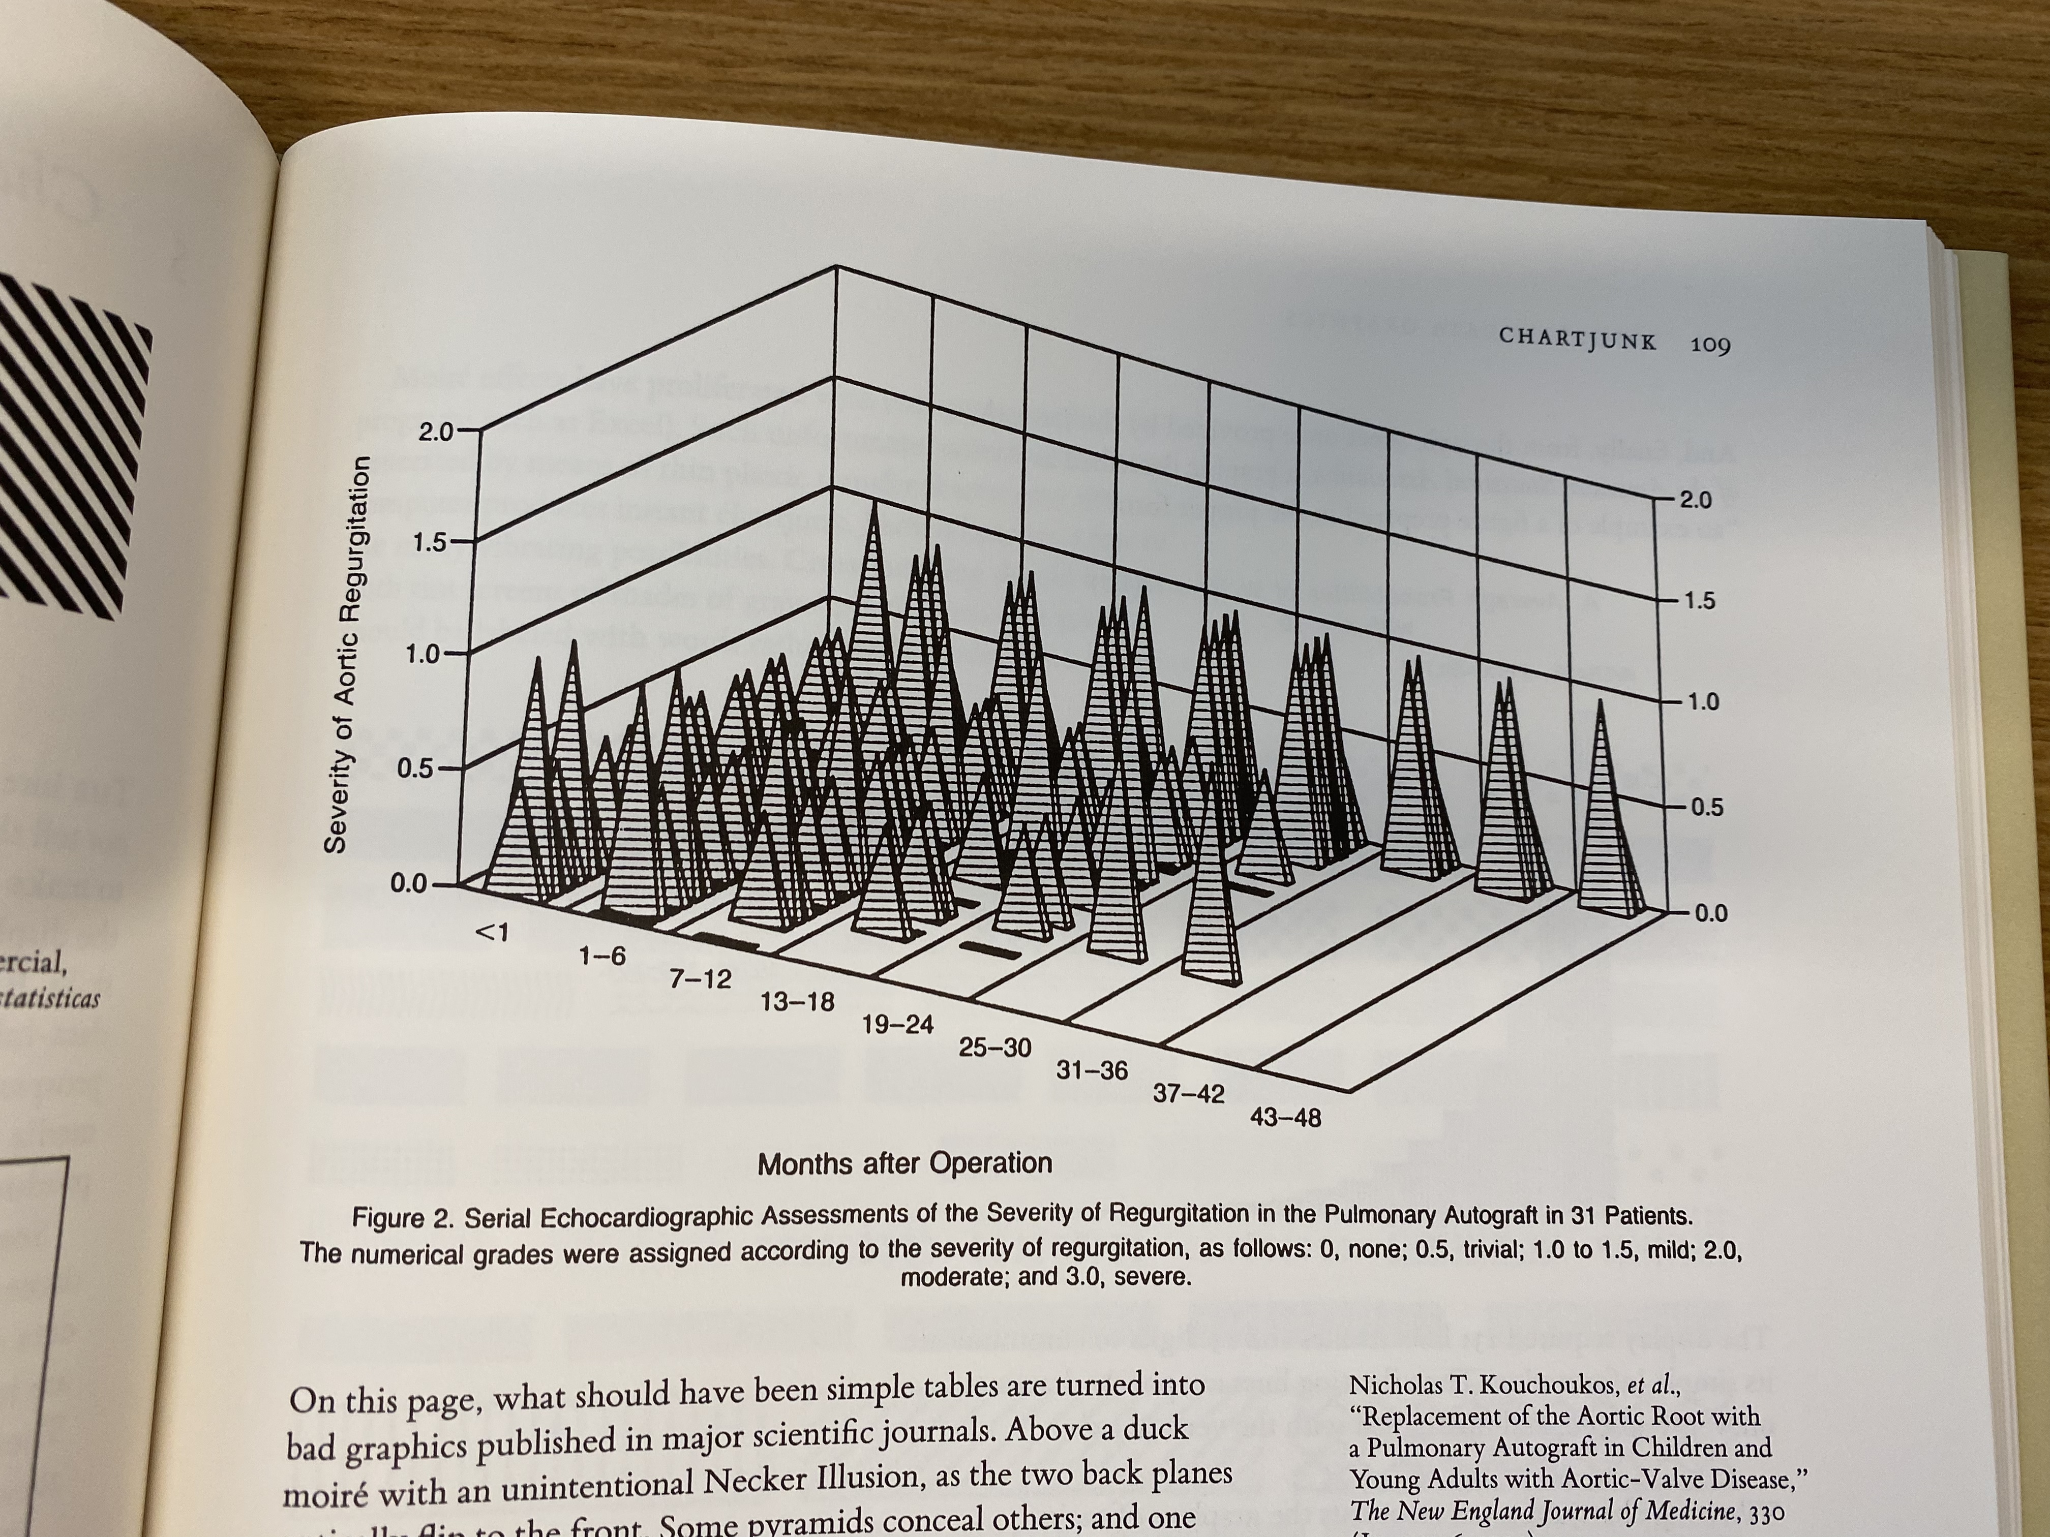
“Chartjunk” is bad

Slide 4
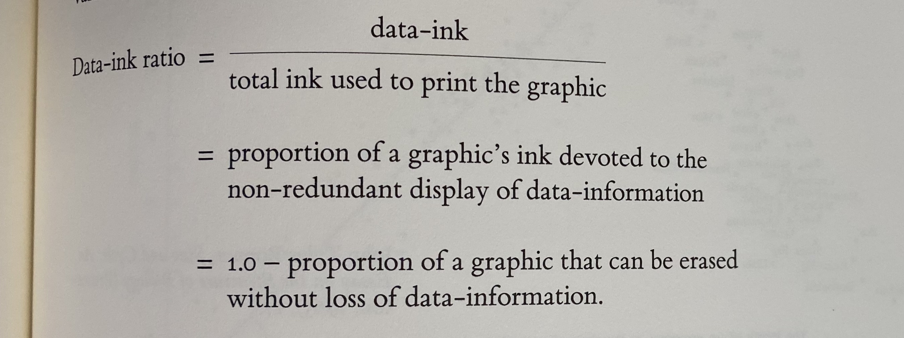
Tufte’s Principle: Data-ink ratio

Slide 5
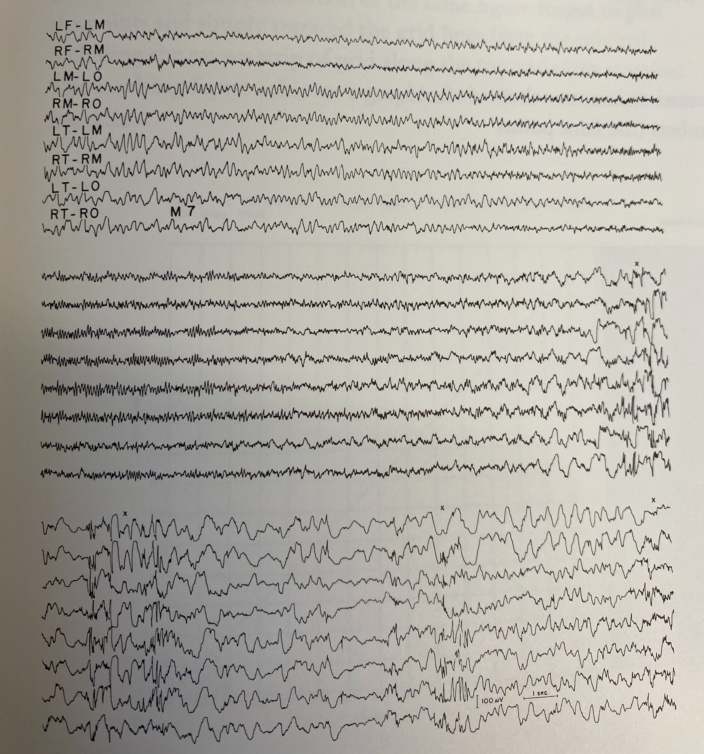
Tufte’s Principle: Data-ink ratio
Tufte’s best example is an electrocardiogram

Slide 6
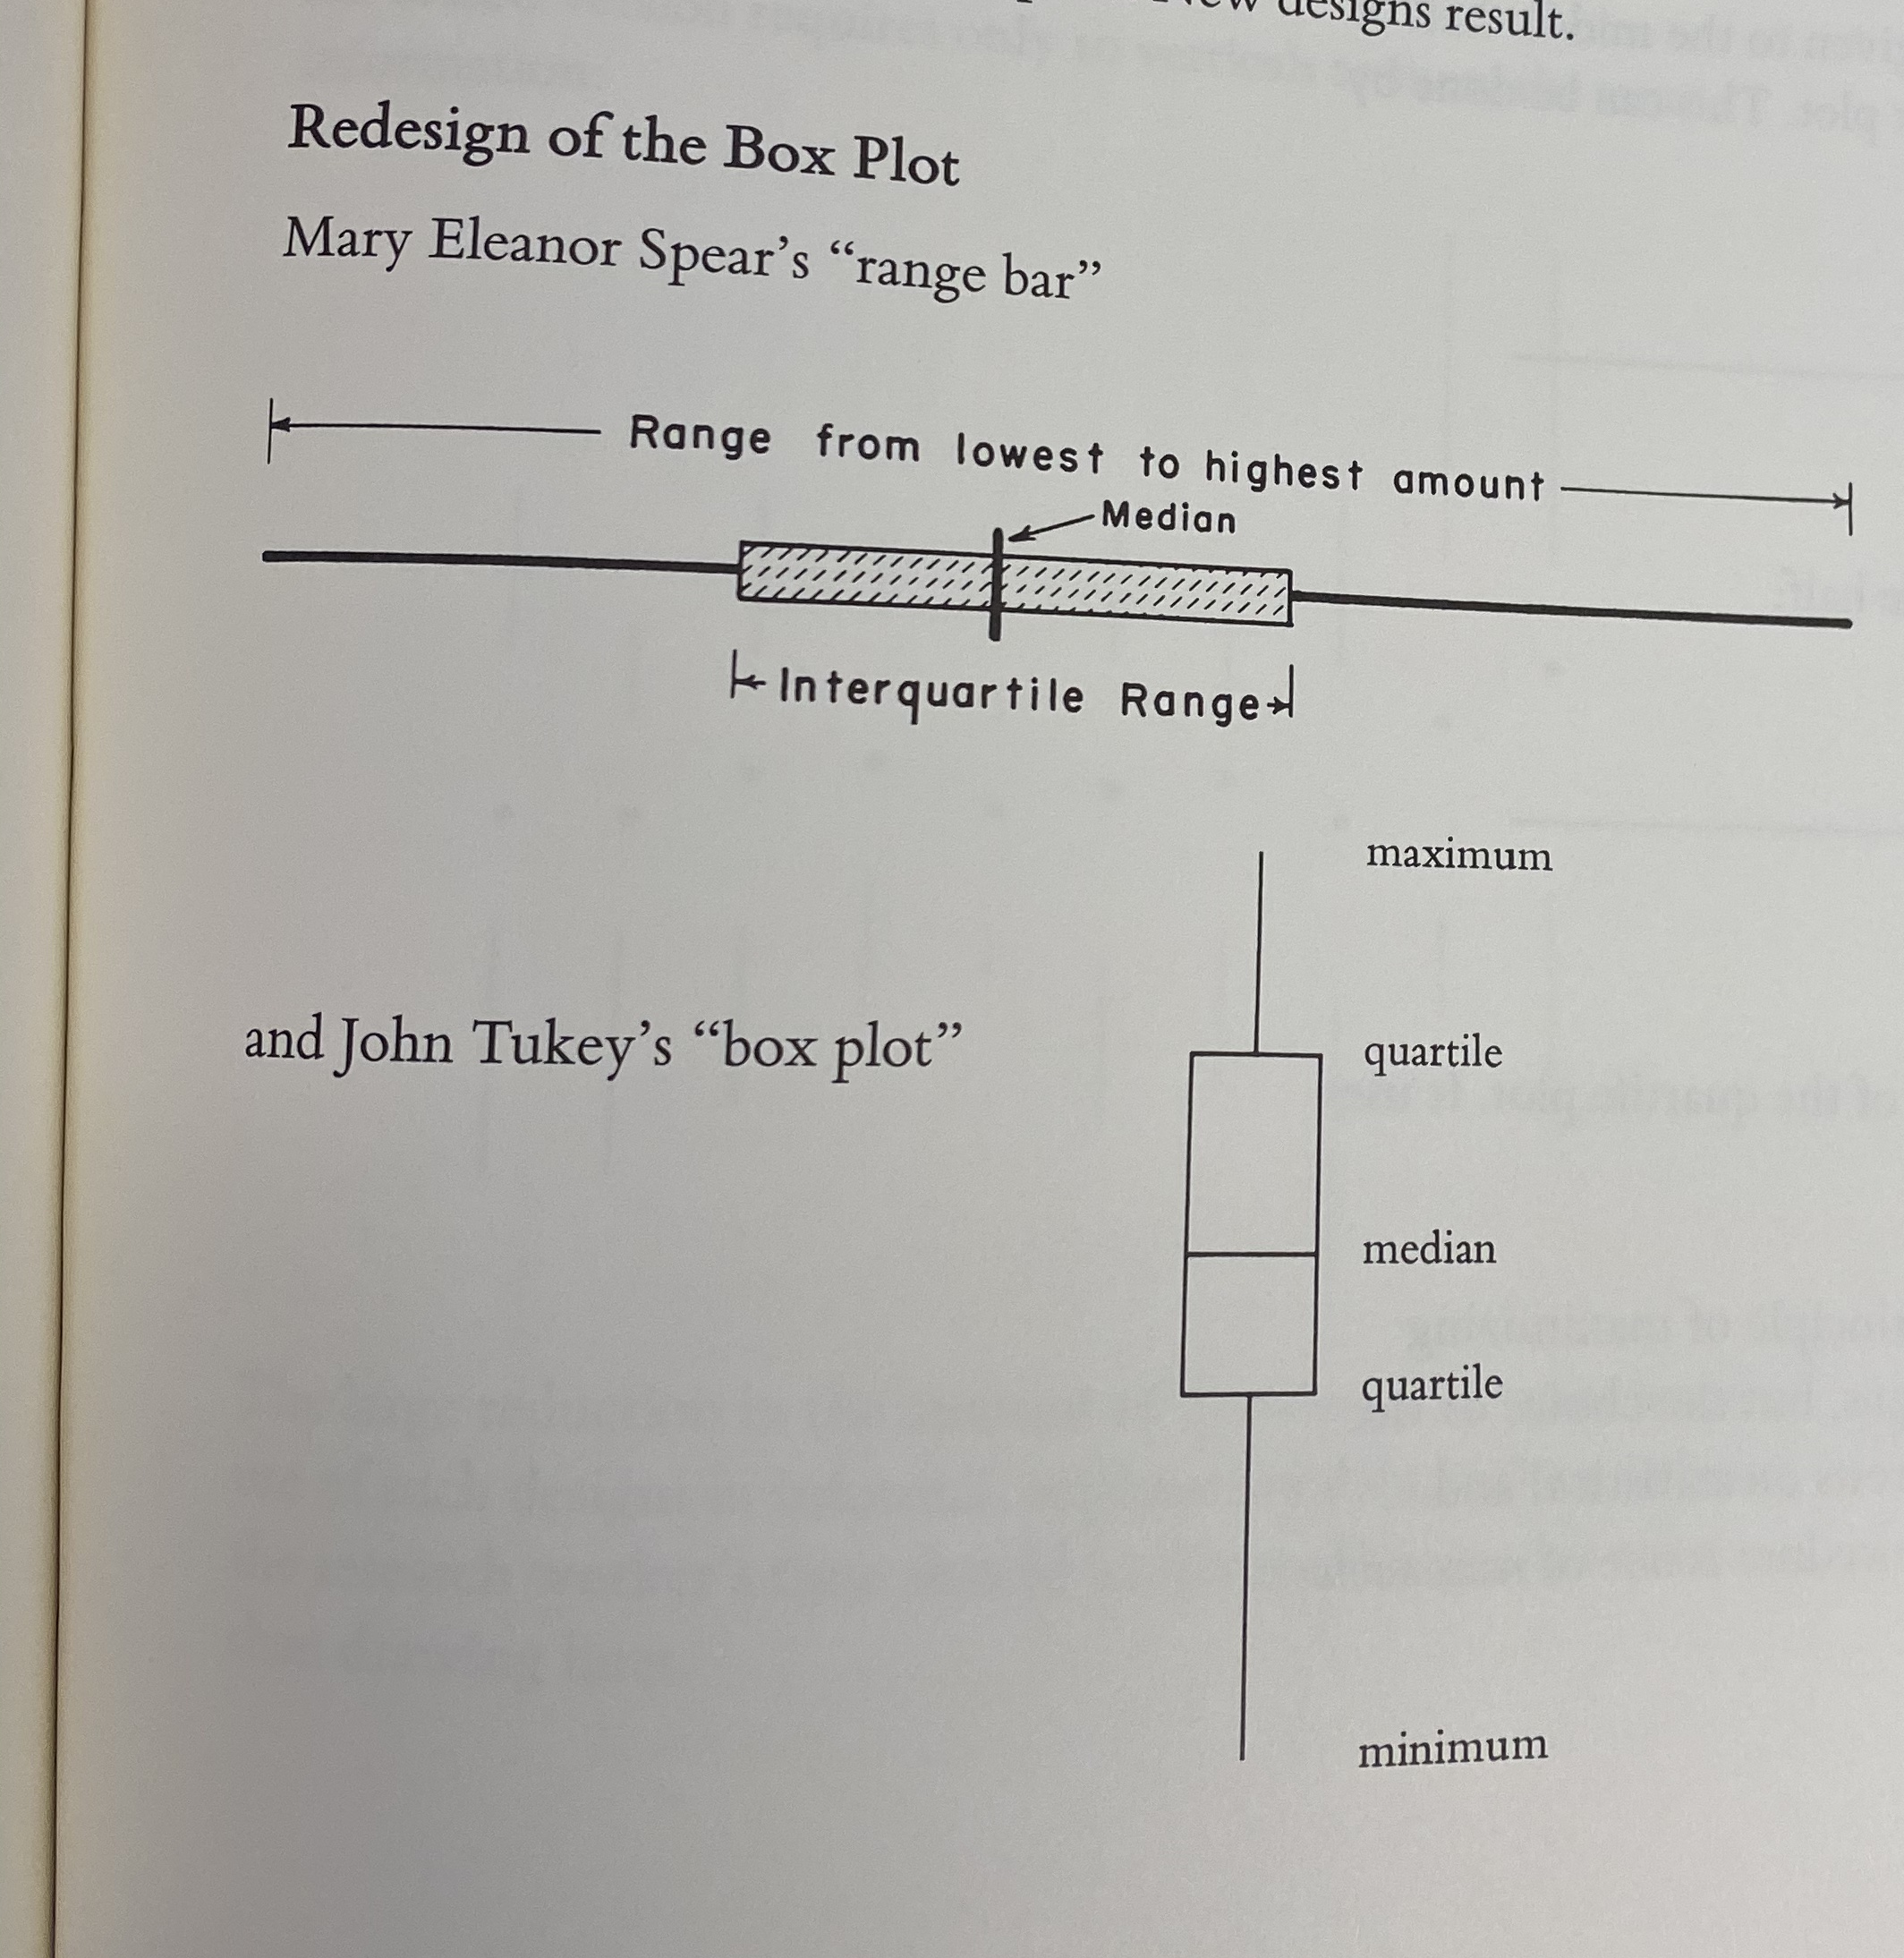
Example 1: Box and whisker plot
Common statistical data representation of a data distribution.

Slide 7
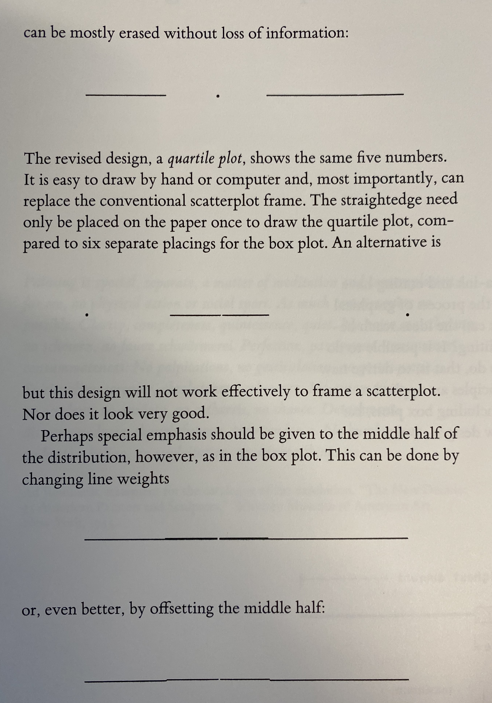
Example 1: Box and whisker plot
Common statistical data representation of a data distribution.

Slide 8
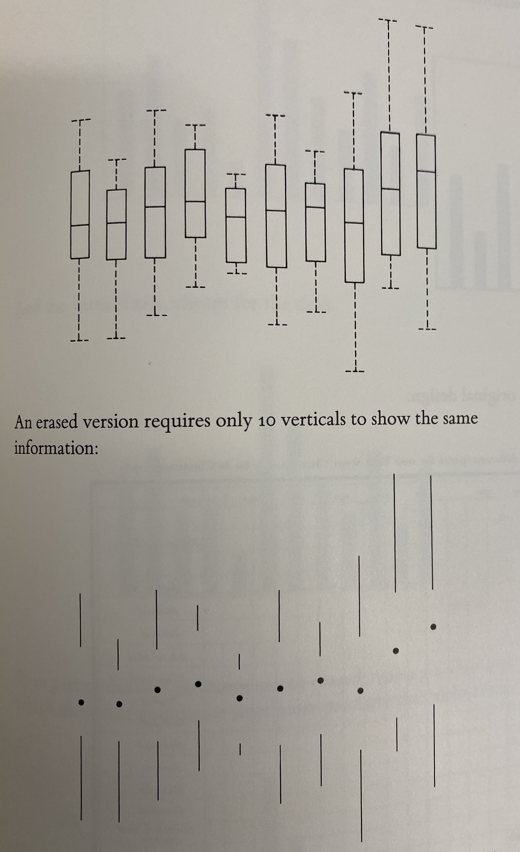
Example 1: Box and whisker plot
Common statistical data representation of a data distribution.

Slide 9
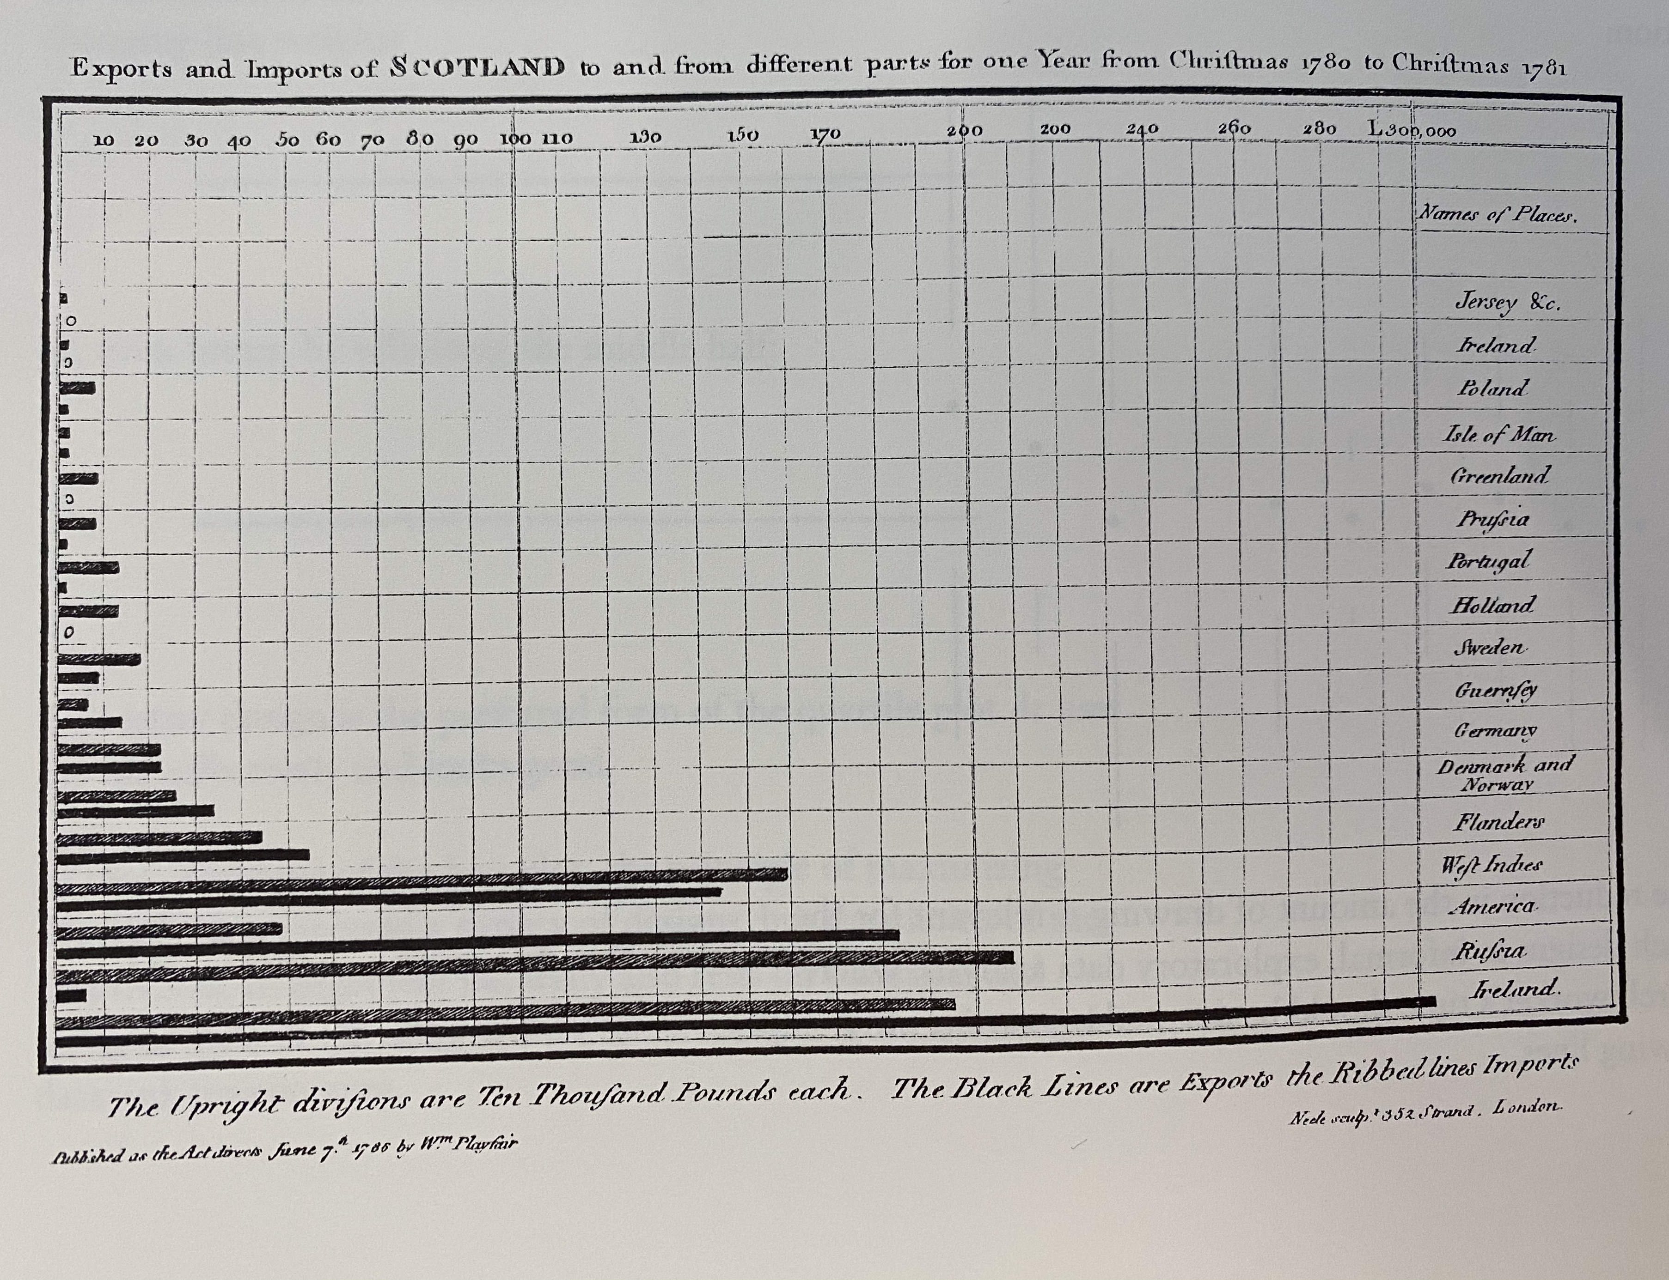
Example 2: Bar chart or histogram
Illustrates and compares absolute magnitudes

Slide 10
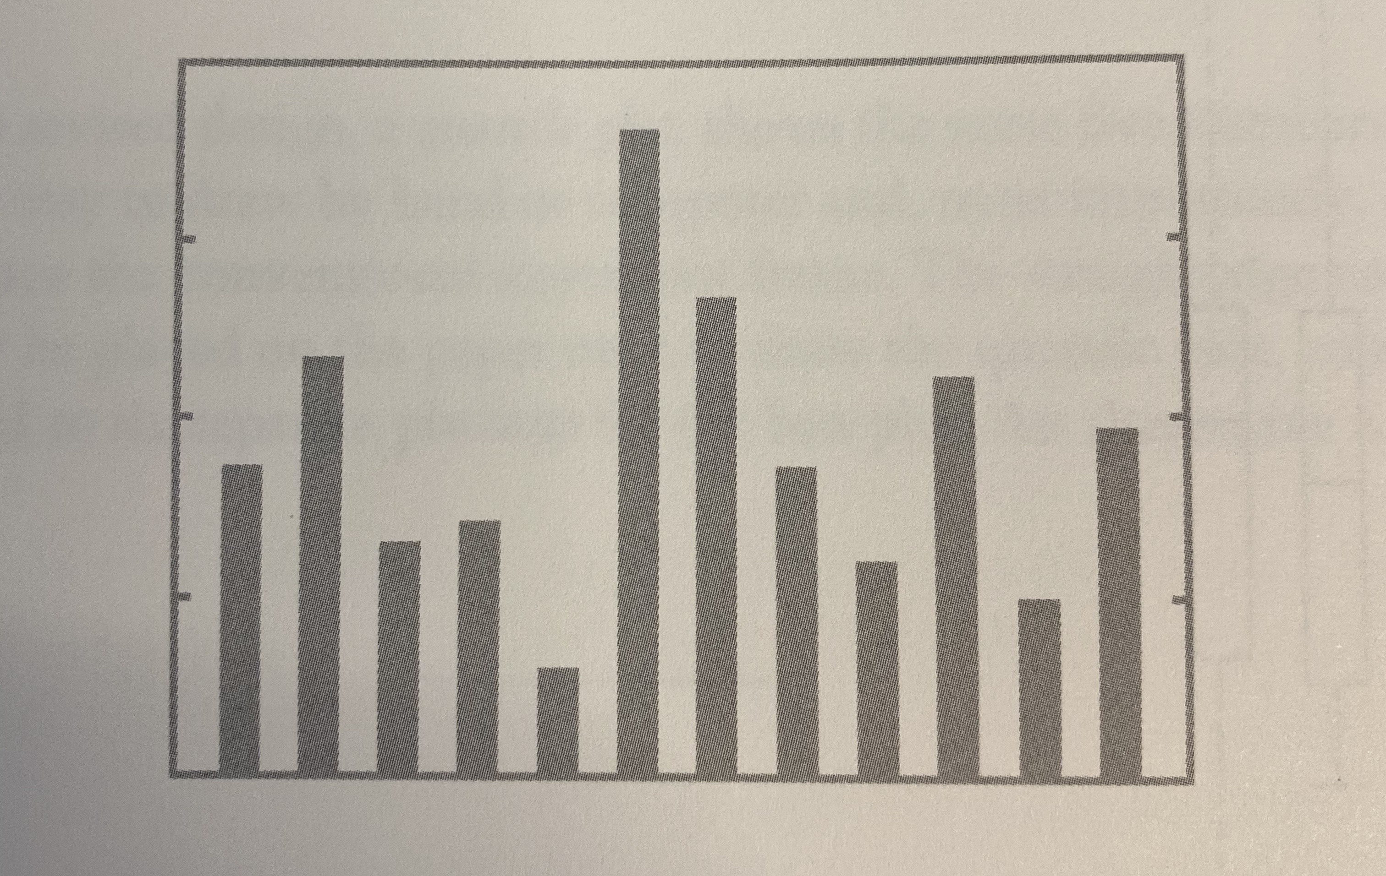
Example 2: Bar chart or histogram
Illustrates and compares absolute magnitudes

Slide 11
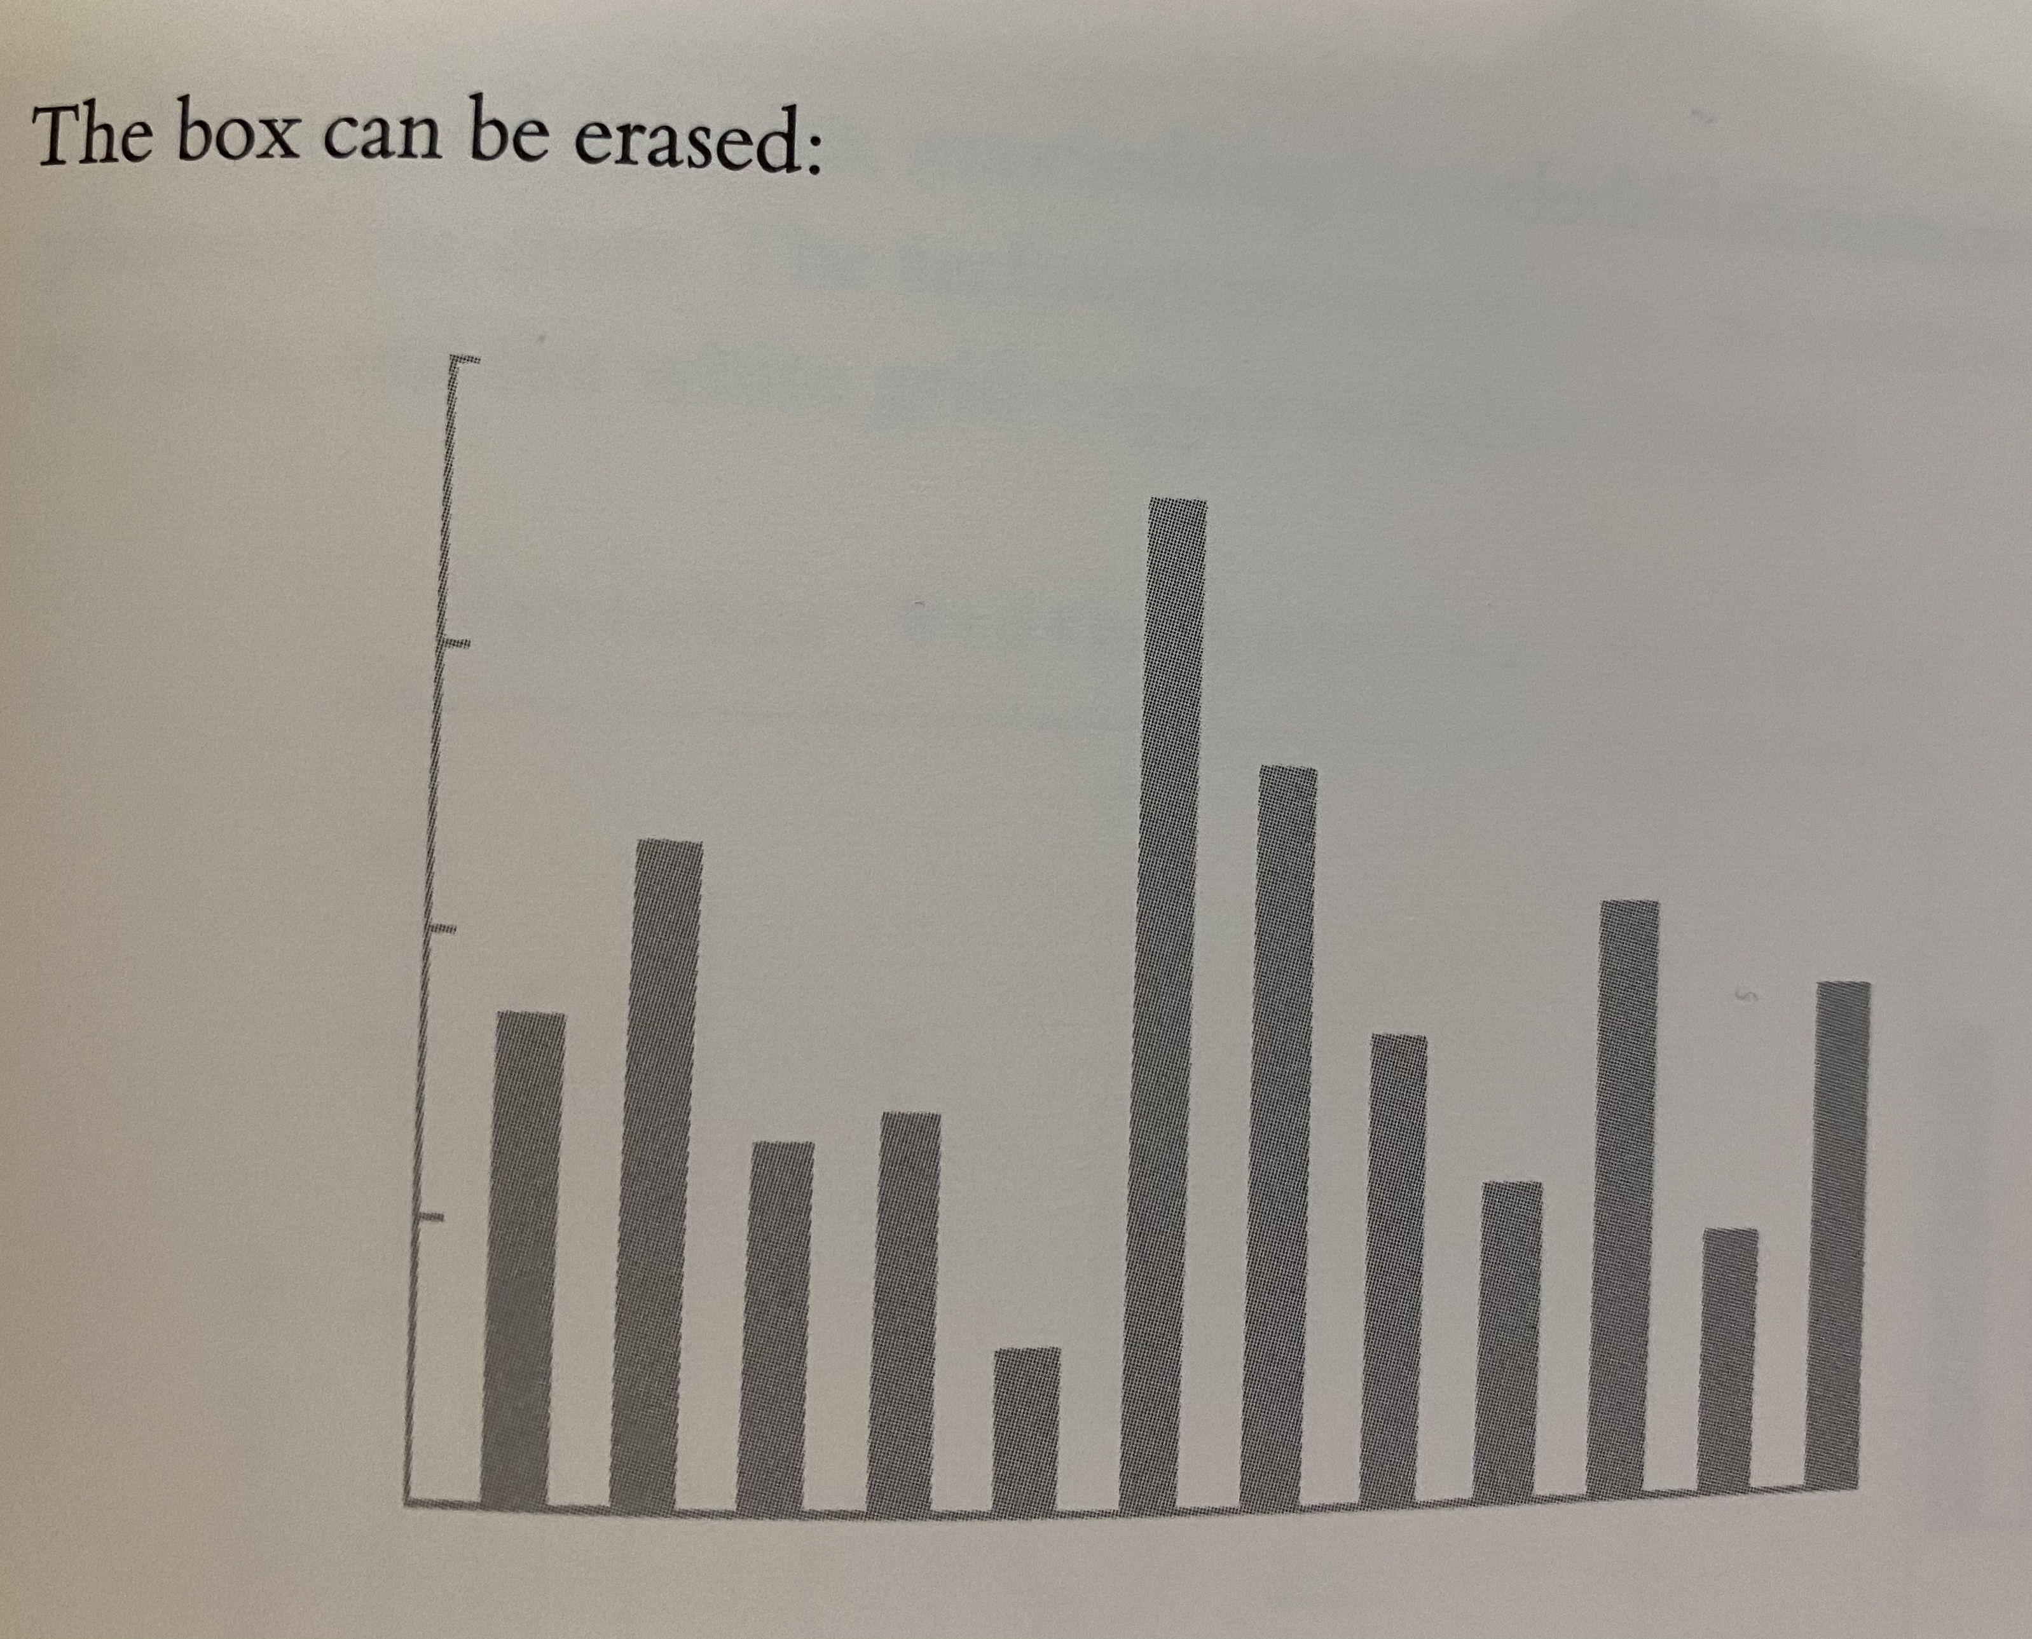
Example 2: Bar chart or histogram
Illustrates and compares absolute magnitudes

Slide 12
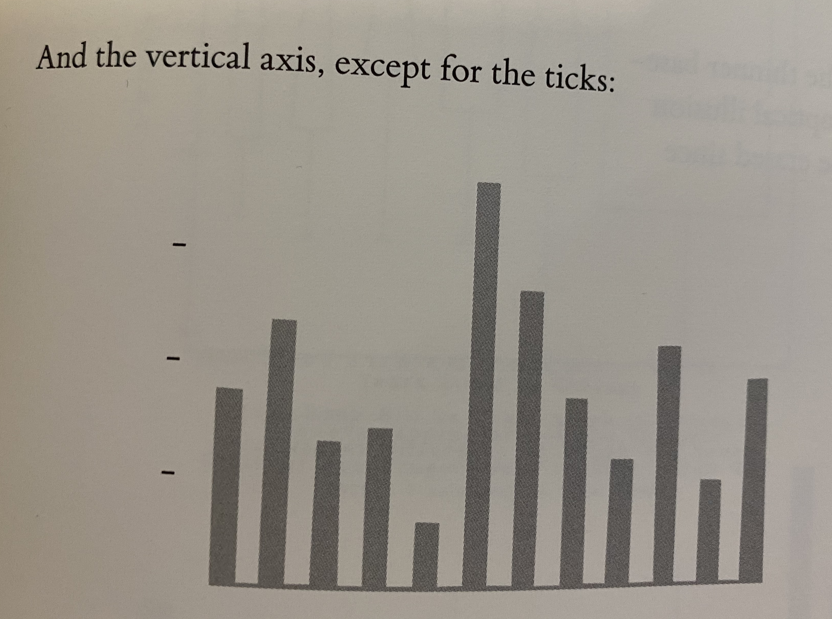
Example 2: Bar chart or histogram
Illustrates and compares absolute magnitudes

Slide 13
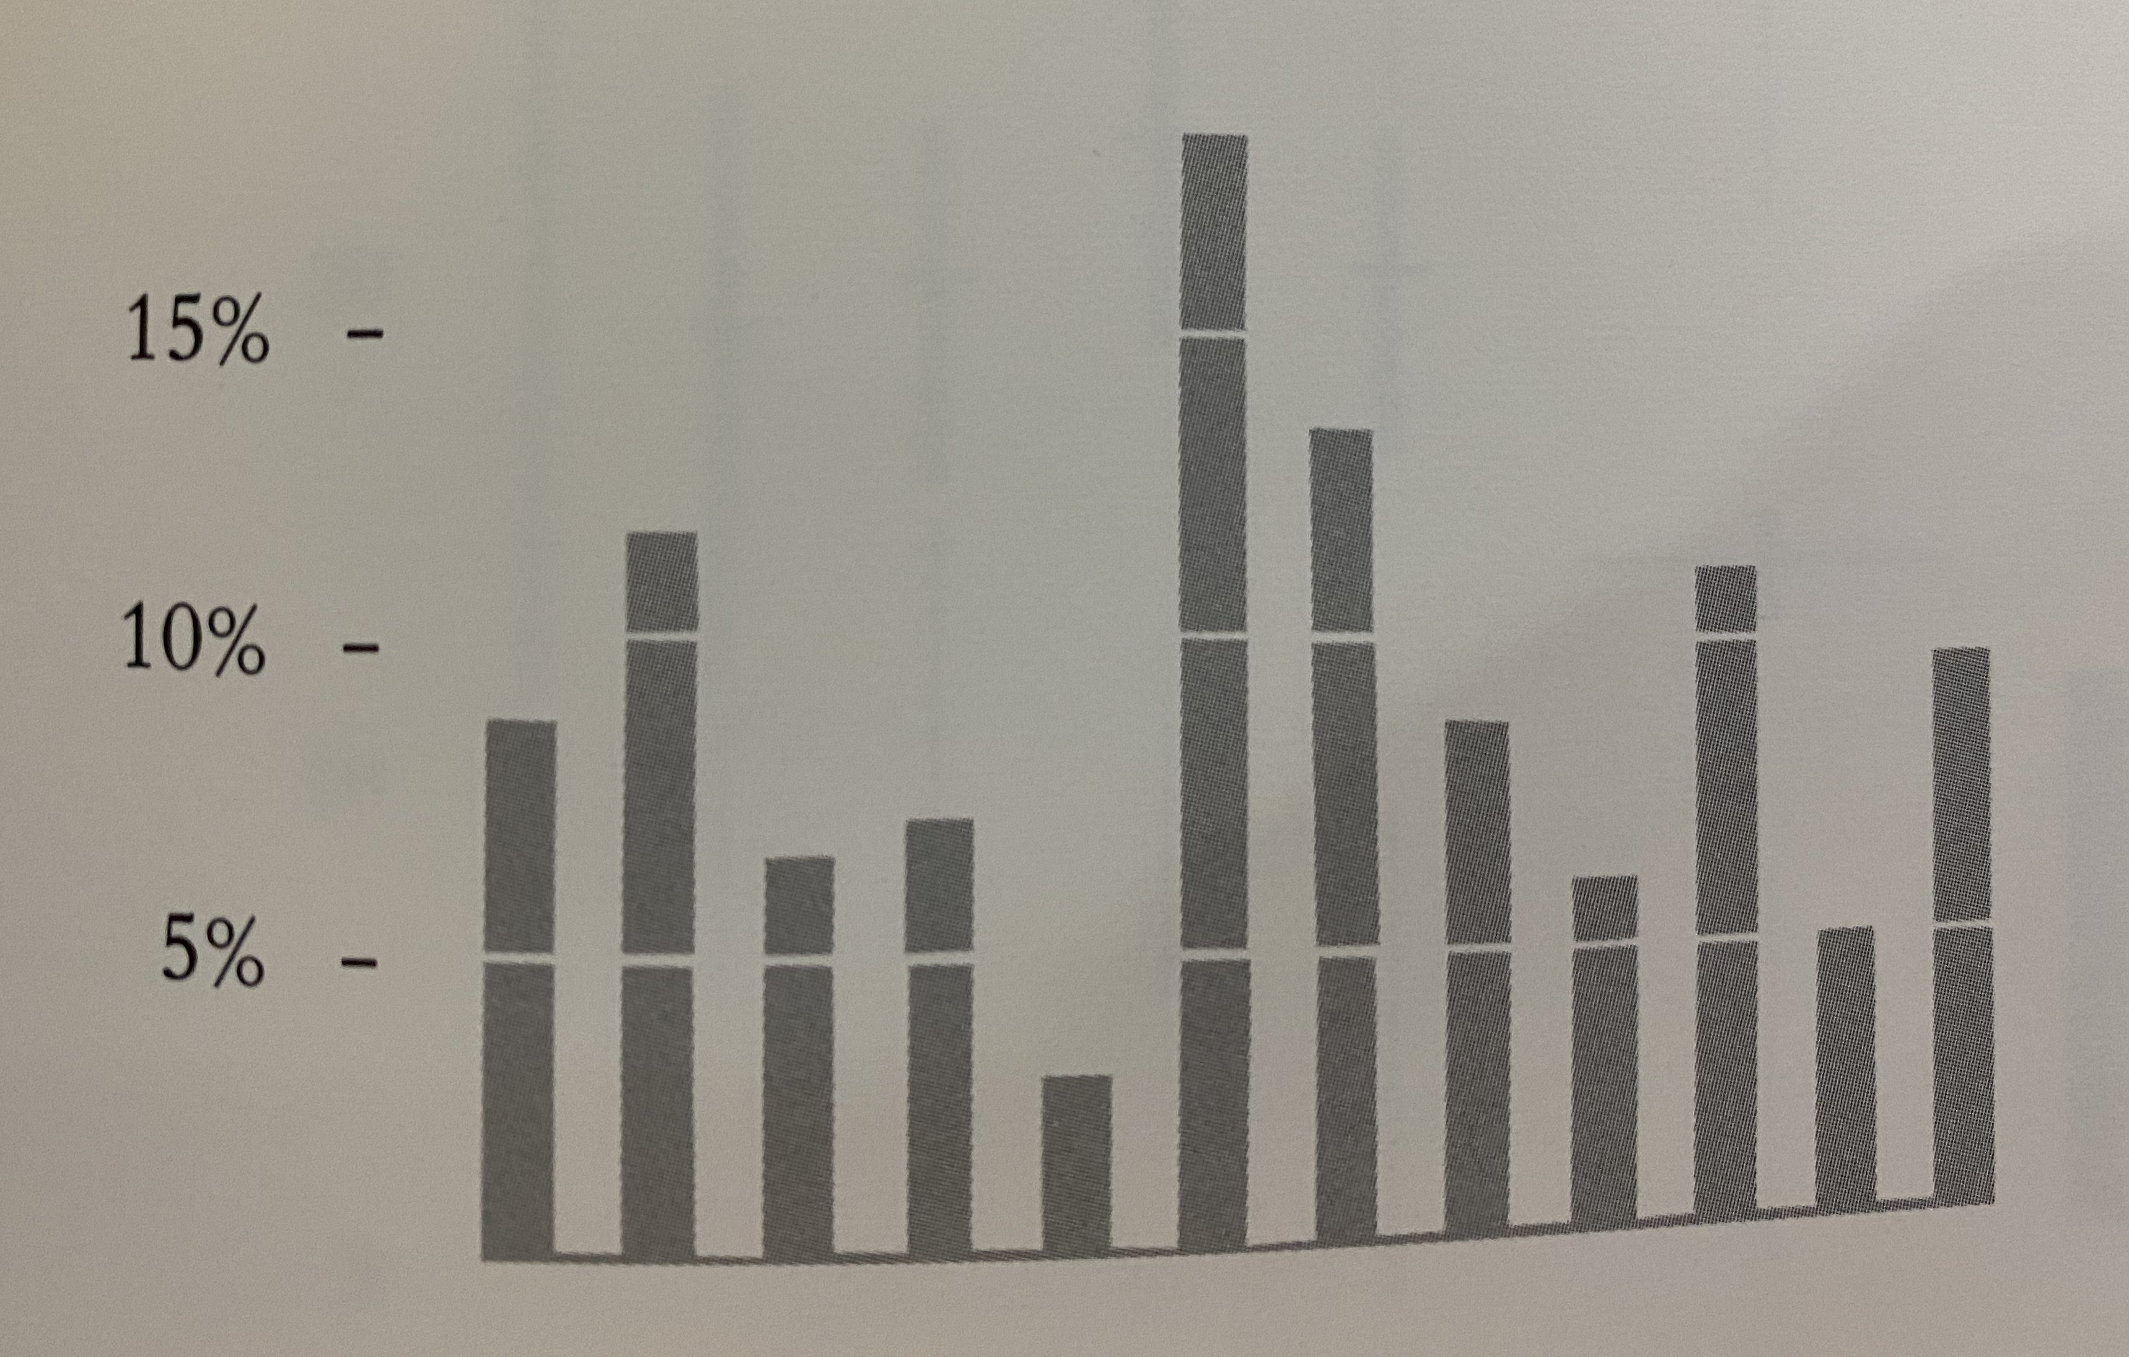
Example 2: Bar chart or histogram
Illustrates and compares absolute magnitudes

Slide 14
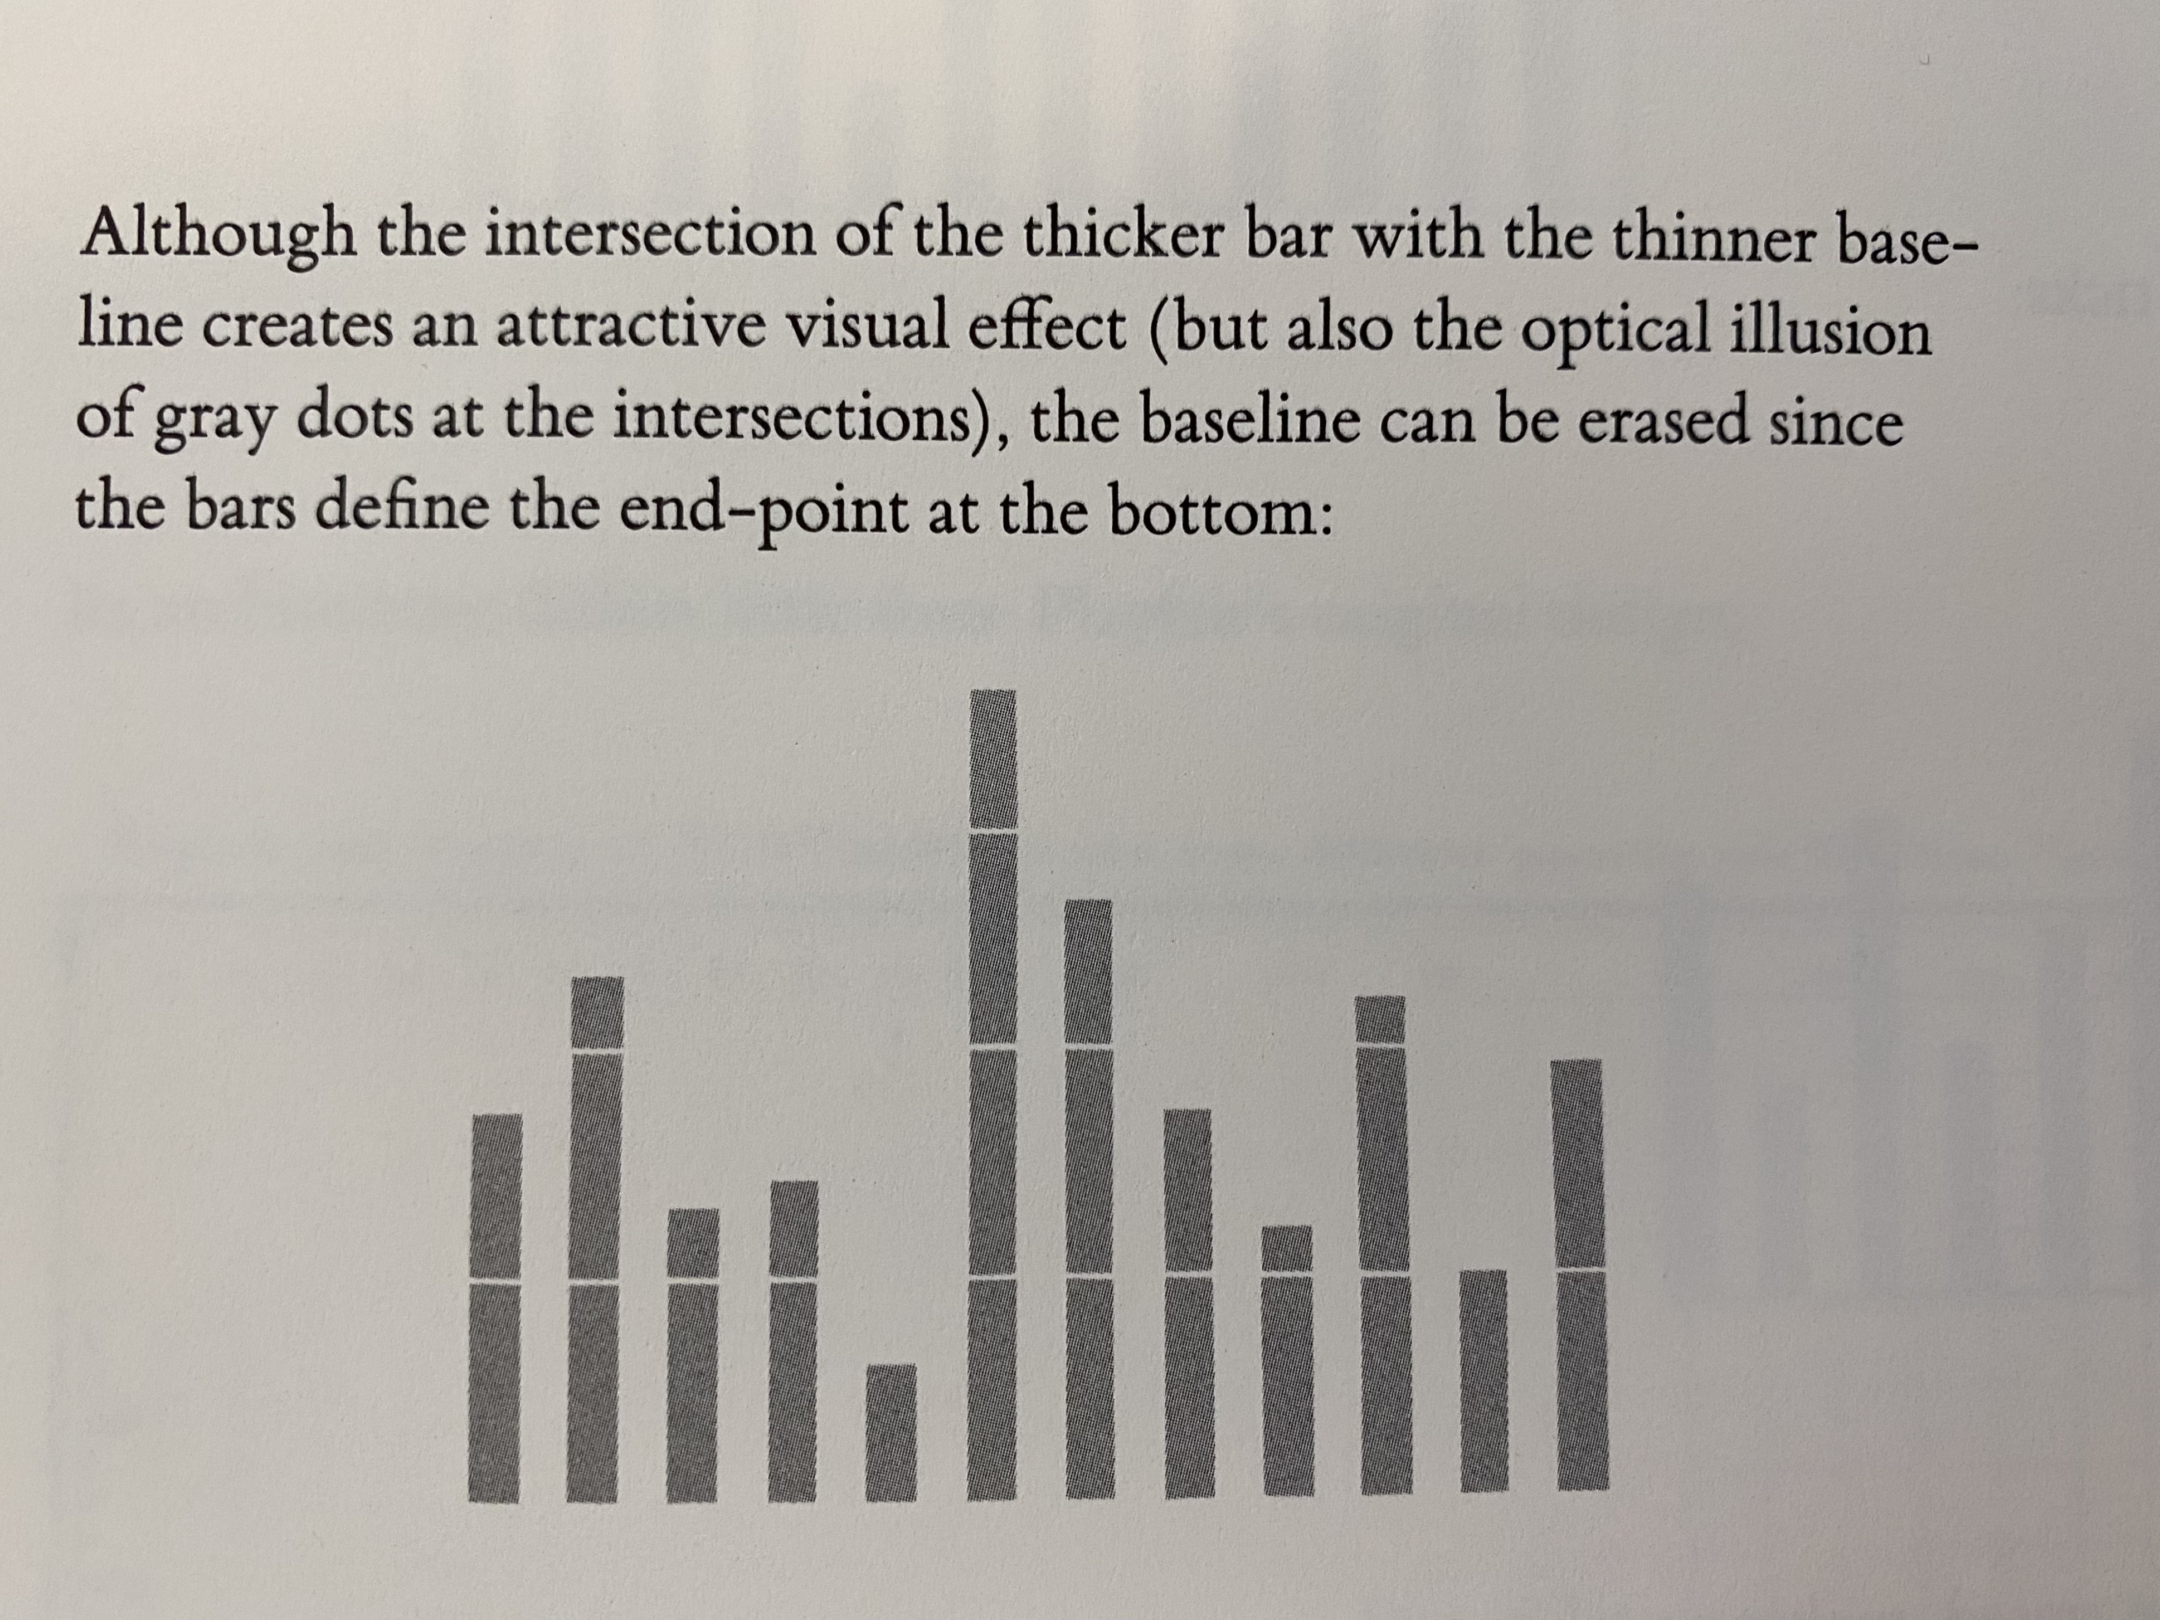
Example 2: Bar chart or histogram
Illustrates and compares absolute magnitudes

Slide 15
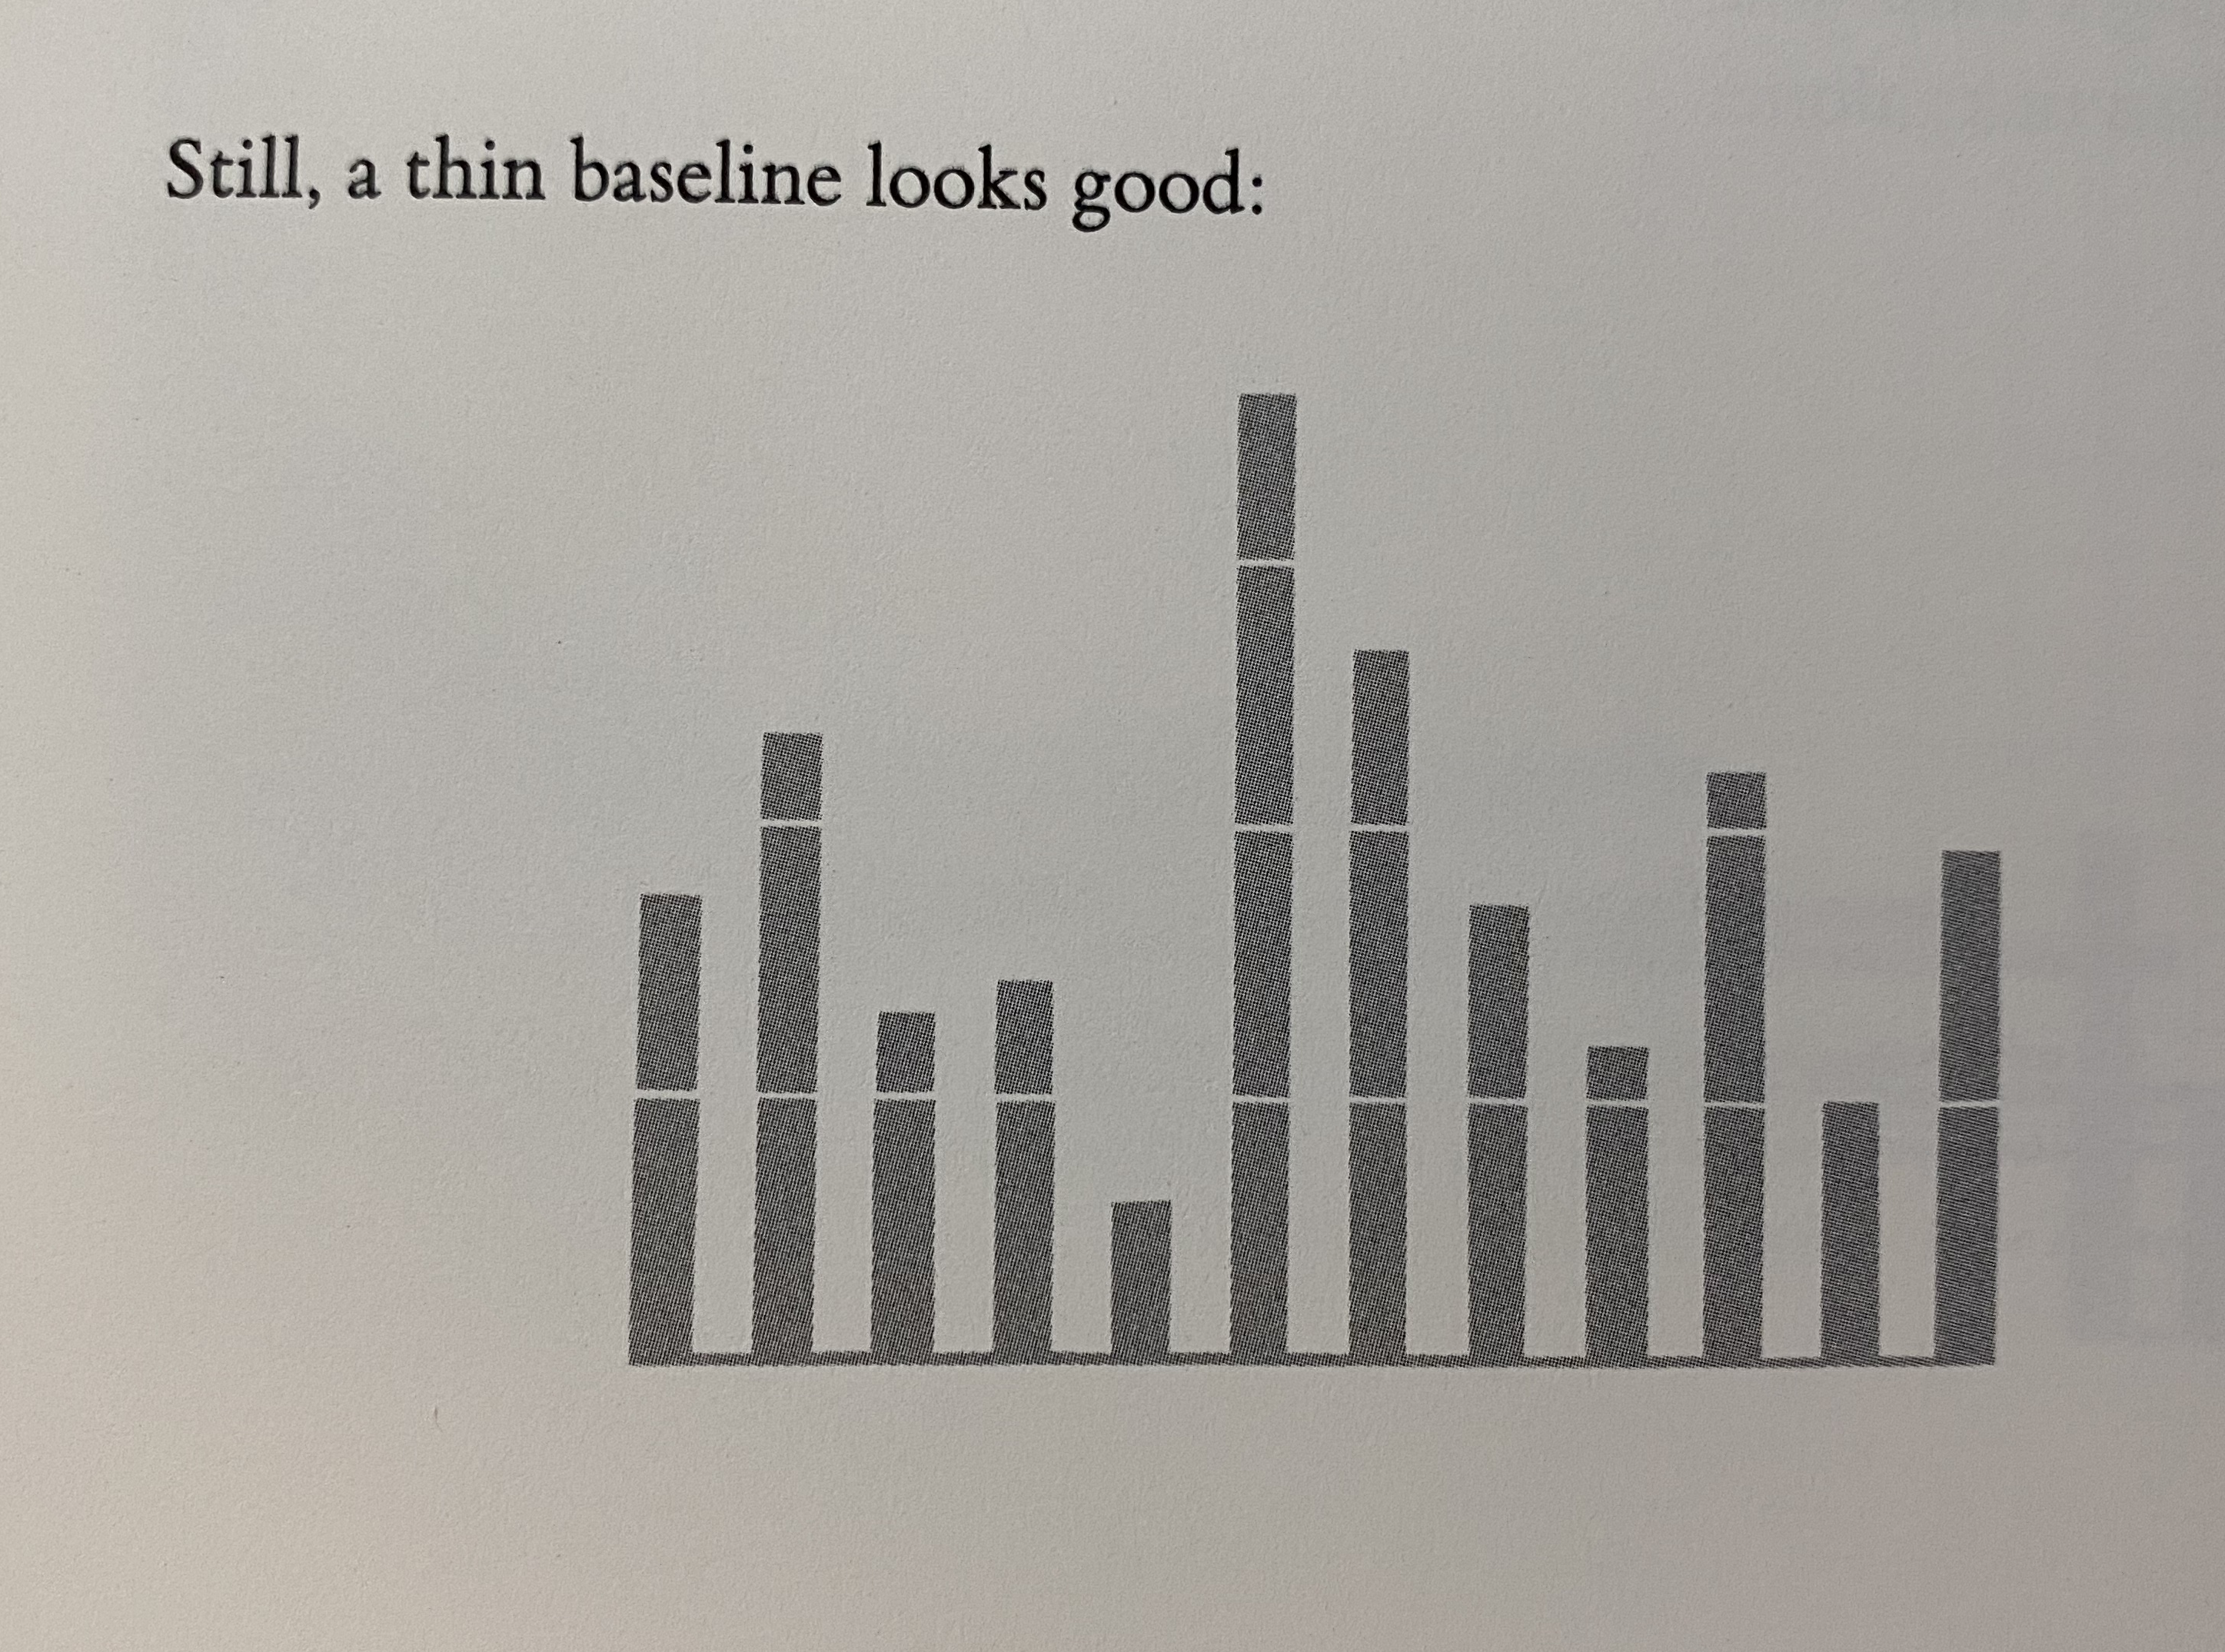
Example 2: Bar chart or histogram
Illustrates and compares absolute magnitudes

